Slide 1
Introduction
Notes:
Today, We’ll be talking about (AIDS), which is a kind of (disease) that affects (the immune system). I’ll first describe the disease and give some basic facts. Next, I’ll explain the main symptoms and effects. Then my partner, (Suzanne), will discuss possible treatments and ways of preventing (AIDS). Finally, we will offer predictions about the future of this disease.

Slide 2
Description/Background

Slide 3
History
Kinishasa 1920

Slide 4
Causes

Slide 5
How you can get it
Bodily Fluids
Blood
Semen
Fluids from a woman's vagina
Fluids from the rectum
Breast milk

Slide 6
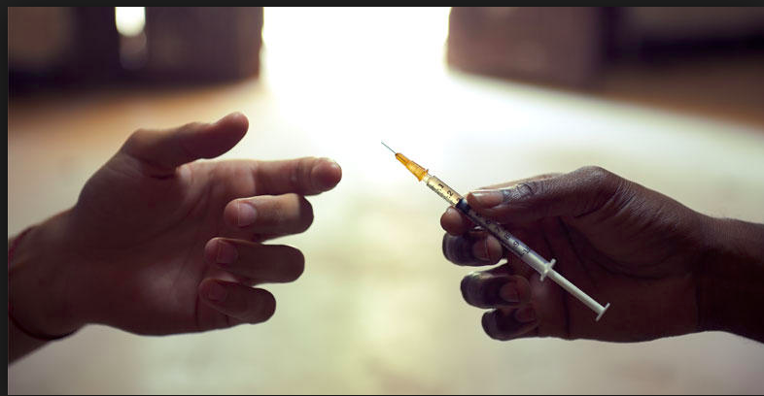
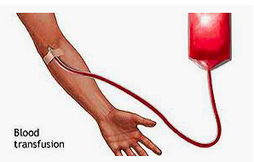
How fluids are transferred

Slide 7
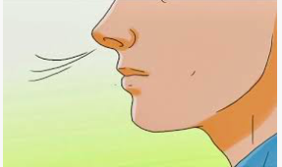
Common myths
You can’t get it from:
Touching
Saliva
Air/Breathing

Slide 8
Symptoms/Effects
3 Phases/Stages
Acute Infection → Clinical Latency → AIDS

Slide 9
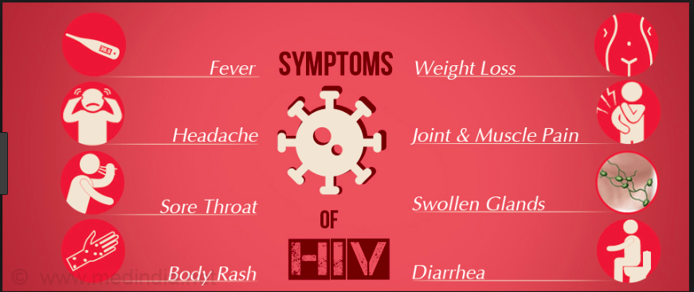
Phase 1: (6-12 weeks) = Acute HIV Syndrome
Flu-like symptoms

Slide 10
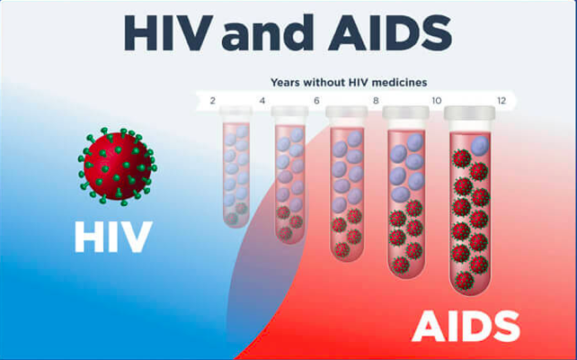
Phase 2: (1-10 years) = Latency period
Immune system getting weaker
Weight loss

Slide 11
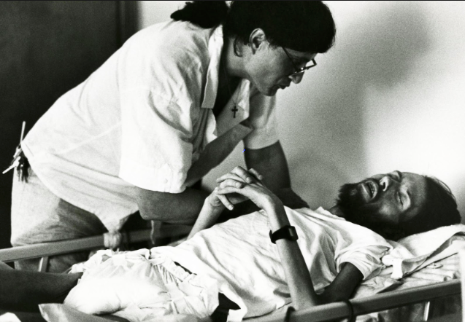
Phase 3 = AIDS. No immune system
Die from illnesses like pneumonia
Normally body can easily fight it off, but…

Slide 12
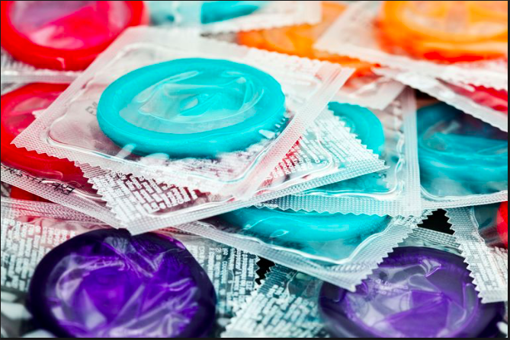
Prevention

Slide 13
Treatments
No cure or vaccine
Antiretroviral therapy (ART)
Side effects =
Nausea, heart disease, weak bones
Future…

